Slide 1
Chapter 6
Assessing the Assumptions of the Regression Model (Part 2)
Terry Dielman
Applied Regression Analysis
for Business and Economics
Checking Assumptions
Copyright © 2005 Brooks/Cole, a division of Thomson Learning, Inc.

Slide 2
Asset Risk
= Systematic Risk + Nonsystematic Risk
Systematic Risk : 증권시장의 불확실성에 따른 위험. 분산투자로 제거되지 않는 위험이므로 Undiversifiable Risk 라고 함.
Nonsystematic Risk : 증권시장의 전반적인 움직임과 관계없는 기업특정 요인 (노사문제, 매출, 기업이미지) 등에 의한 위험. 분산투자로 제거가능하므로 Diversifiable Risk 라고 함.
Checking Assumptions
Copyright © 2005 Brooks/Cole, a division of Thomson Learning, Inc.

Slide 3
베타 & 시그마
베타 (Beta) : 체계적 위험에 대한 측정변수의 하나로서, 증권시장의 수익률 변동에 대한 특정기업의 수익률 변동 비율
시그마 (Sigma) : 주식의 총 변동으로 전체 위험도를 나타내는 측정변수
Checking Assumptions
Copyright © 2005 Brooks/Cole, a division of Thomson Learning, Inc.

Slide 4
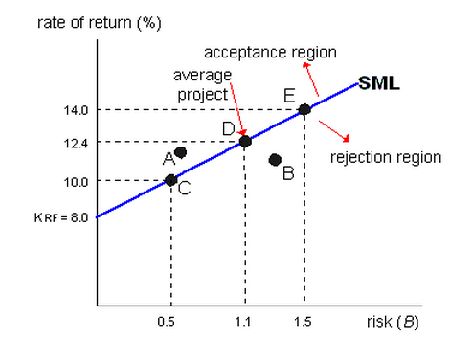
SML(Security Market Line)
Risk free
The higher risk is, the higher the return rate is required
Checking Assumptions
Copyright © 2005 Brooks/Cole, a division of Thomson Learning, Inc.

Slide 5
Example 6.7 S&L Rate of Return
Data set SL6
n =35 Saving and Loans stocks
Y = rate of return for 5 years ending 1982
X₁ = the "Beta" of the stock
X₂ = the "Sigma" of the stock
Beta is a measure of nondiversifiable risk and Sigma a measure of total risk
Checking Assumptions
Copyright © 2005 Brooks/Cole, a division of Thomson Learning, Inc.

Slide 6
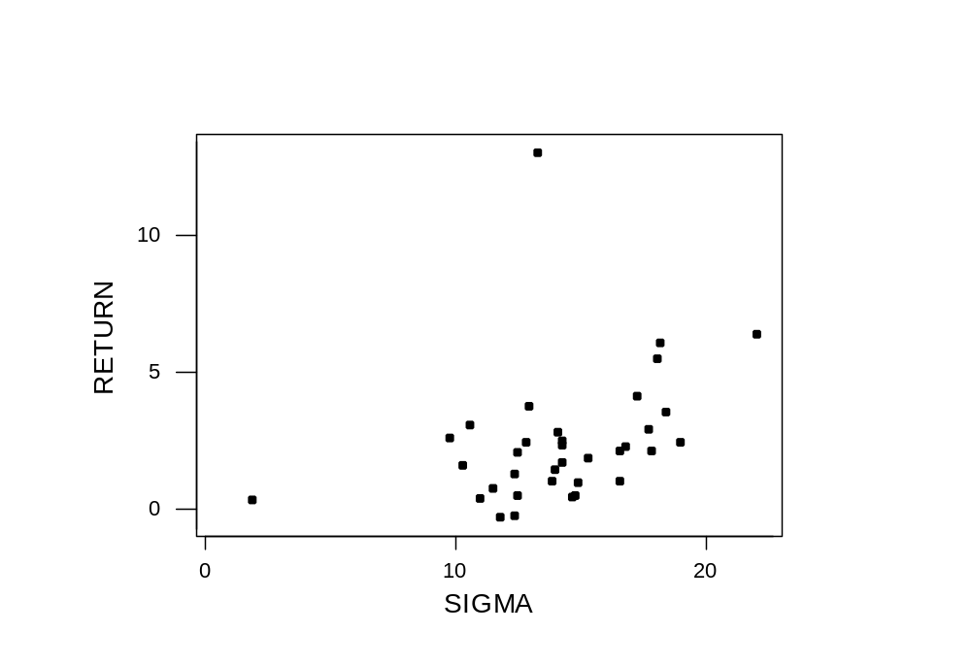
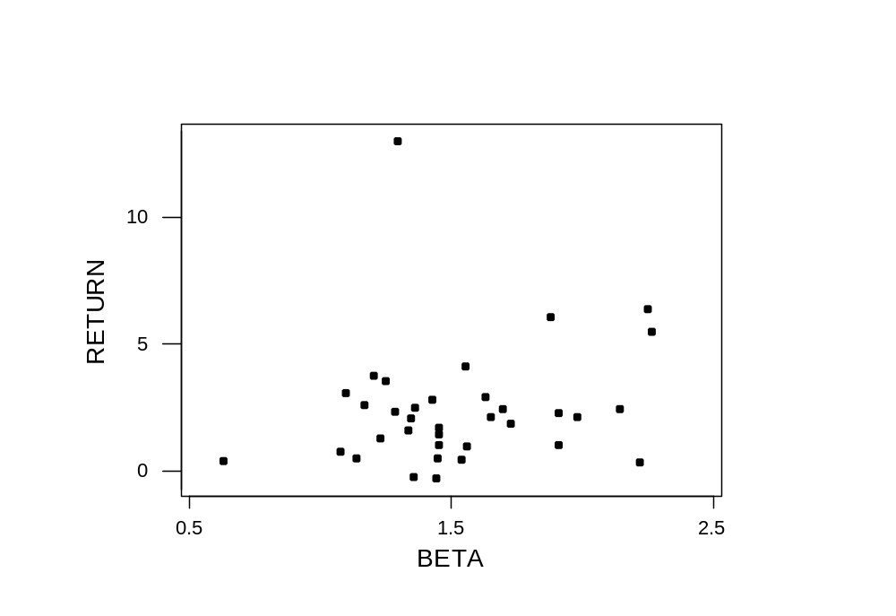
Basic exploration
Correlations: RETURN, BETA, SIGMA
RETURN BETA
BETA 0.180
SIGMA 0.351 0.406
Checking Assumptions
Copyright © 2005 Brooks/Cole, a division of Thomson Learning, Inc.

Slide 7
Not much explanatory power
The regression equation is
RETURN = - 1.33 + 0.30 BETA + 0.231 SIGMA
Predictor Coef SE Coef T P
Constant -1.330 2.012 -0.66 0.513
BETA 0.300 1.198 0.25 0.804
SIGMA 0.2307 0.1255 1.84 0.075
S = 2.377 R-Sq = 12.5% R-Sq(adj) = 7.0%
Analysis of Variance
(deleted)
Unusual Observations
Obs BETA RETURN Fit SE Fit Residual St Resid
19 2.22 0.300 -0.231 2.078 0.531 0.46 X
29 1.30 13.050 2.130 0.474 10.920 4.69R
R denotes an observation with a large standardized residual
X denotes an observation whose X value gives it large influence.
Checking Assumptions
Copyright © 2005 Brooks/Cole, a division of Thomson Learning, Inc.

Slide 8
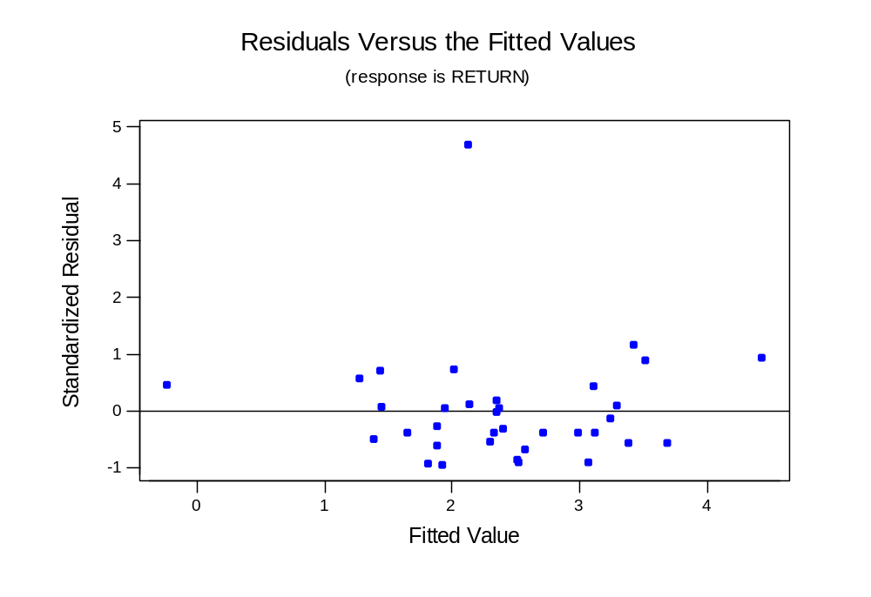
One in every crowd? (outlier / normality)
Checking Assumptions
Copyright © 2005 Brooks/Cole, a division of Thomson Learning, Inc.

Slide 9
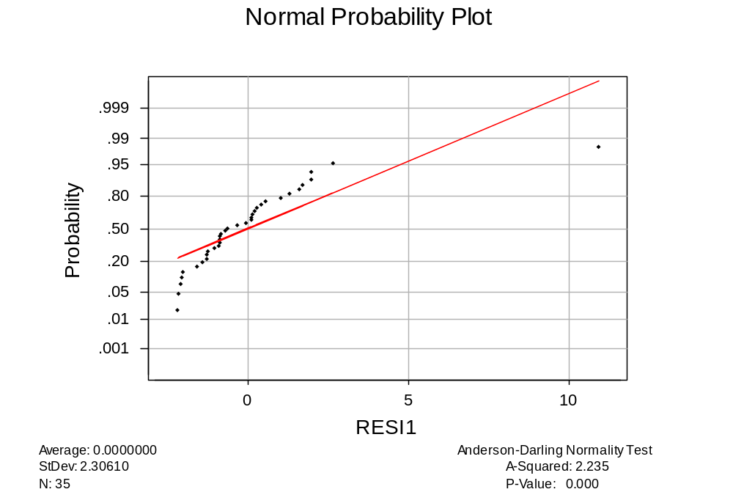
Normality Test
Reject
H₀: Normality
Checking Assumptions
Copyright © 2005 Brooks/Cole, a division of Thomson Learning, Inc.

Slide 10
6.6.3 Corrections for Nonnormality
Normality is not necessary for making inference with large samples.
It is required for inference with small samples.
The remedies are similar to those used to correct for nonconstant variance.
Checking Assumptions
Copyright © 2005 Brooks/Cole, a division of Thomson Learning, Inc.

Slide 11
Influential Point (영향점)
Checking Assumptions
Copyright © 2005 Brooks/Cole, a division of Thomson Learning, Inc.

Slide 12
6.7 Influential Observations
In minimizing SSE, the least squares procedure tries to avoid large residuals.
It thus "pays a lot of attention" to y values that don't fit the usual pattern in the data. Refer to the example in Figures 6.42(a) and 6.42(b).
That probably also happened in the S&L data where the one very high return masked the relationship between rate of return, beta and sigma for the other 34 stocks.
Checking Assumptions
Copyright © 2005 Brooks/Cole, a division of Thomson Learning, Inc.

Slide 13
6.7.2 Identifying outliers
Minitab flags any residual bigger than 2 in absolute value as a potential outlier.
A boxplot of the residuals uses a slightly different rule, but should give similar results.
There is also a third type of residual that is often used for this purpose.
Checking Assumptions
Copyright © 2005 Brooks/Cole, a division of Thomson Learning, Inc.

Slide 14
One in every crowd? (outlier / normality)
Checking Assumptions
Copyright © 2005 Brooks/Cole, a division of Thomson Learning, Inc.

Slide 15
Deleted residuals (skip !)
If you (temporarily) eliminate the i^{th} observation from the data set, it cannot influence the estimation process.
You can then compute a "deleted" residual to see if this point fits the pattern in the other observations.
Checking Assumptions
Copyright © 2005 Brooks/Cole, a division of Thomson Learning, Inc.

Slide 16
Deleted Residual Illustration (skip !!)
The regression equation is
ReturnWO29 = - 2.51 + 0.846 BETA + 0.232 SIGMA
34 cases used 1 cases contain missing values
Predictor Coef SE Coef T P
Constant -2.510 1.153 -2.18 0.037
BETA 0.8463 0.6843 1.24 0.225
SIGMA 0.23220 0.07135 3.25 0.003
S = 1.352 R-Sq = 37.2% R-Sq(adj) = 33.1%
Without observation 29, we get a much better fit.
Predicted Y₂₉ = -2.51 + .846(1.2973) + .232(13.3110) = 1.678
Prediction SE is 1.379
Deleted residual₂₉ = (13.05 – 1.678)/1.379 = 8.24
Checking Assumptions
Copyright © 2005 Brooks/Cole, a division of Thomson Learning, Inc.

Slide 17
The influence of observation 29
(skip !!)
When it was temporarily removed, the R² went from 12.5% to 37.2% and we got a very different equation
The deleted residual for this observation was a whopping 8.24, which shows it had a lot of weight in determining the original equation.
Checking Assumptions
Copyright © 2005 Brooks/Cole, a division of Thomson Learning, Inc.

Slide 18
Outlier (이상점) : Y-direction
Leverage Point (지렛대점): X-direction
Influential Point (영향점)
Checking Assumptions
Copyright © 2005 Brooks/Cole, a division of Thomson Learning, Inc.

Slide 19
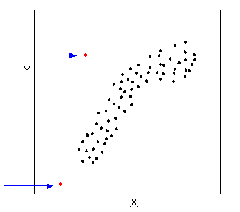
Influential Point (영향점)
Outlier
Leverage point
Checking Assumptions
Copyright © 2005 Brooks/Cole, a division of Thomson Learning, Inc.

Slide 20
6.7.3 Identifying Leverage Points
Outliers have unusual y values; data points with unusual X values are said to have leverage. Minitab flags these with an X.
These points can have a lot of influence in determining the Yhat equation, particularly if they don't fit well. Minitab would flag these with both an R and an X.
Checking Assumptions
Copyright © 2005 Brooks/Cole, a division of Thomson Learning, Inc.

Slide 21
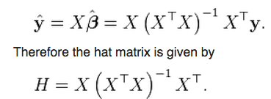
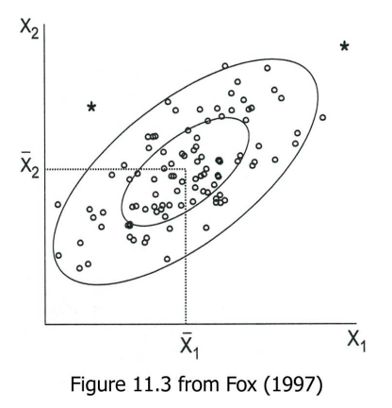
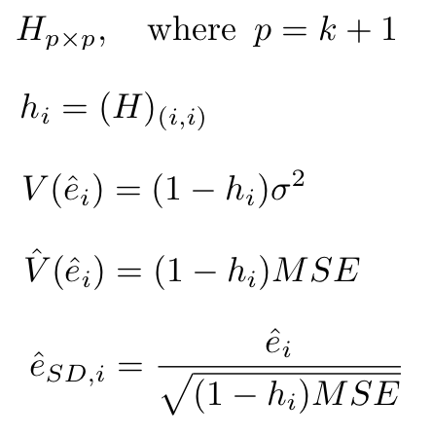
Contour Plot for the h_i
Copyright © 2005 Brooks/Cole, a division of Thomson Learning, Inc.

Slide 22
Leverage
The leverage of the i^{th} observation is h_{i} (it is hard to show where this comes from without matrix algebra).
If h > 2(K+1)/n it has high leverage.
For S&P returns, k = 2 and n = 35 so the benchmark is 2(3)/35 = .171
Observation 19 has a very small value for Sigma, this is the reason why it has h₁₉ = .764
Checking Assumptions
Copyright © 2005 Brooks/Cole, a division of Thomson Learning, Inc.

Slide 23
Leverage Point
h > 2(K+1)/n= 0.171
h₁₉ = .764
Checking Assumptions
Copyright © 2005 Brooks/Cole, a division of Thomson Learning, Inc.

Slide 24
6.7.4 Combined Measures
The effect of an observation on the regression line is a function of both the y and X values.
Several statistics have been developed that attempt to measure combined influence.
The DFIT statistic and Cook's D are two more-popular measures.
Checking Assumptions
Copyright © 2005 Brooks/Cole, a division of Thomson Learning, Inc.

Slide 25
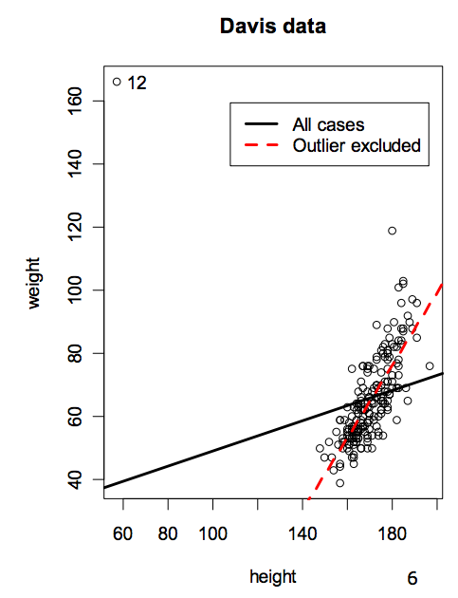
Leverage & Outlier
Is there any Combined Measure?
Checking Assumptions
Copyright © 2005 Brooks/Cole, a division of Thomson Learning, Inc.

Slide 26
The DFIT statistic
The DFIT statistic is a function of both the residual and the leverage.
Minitab can compute and save these under "Storage".
Sometimes a cutoff is used, but it is perhaps best just to look for values that are high.
Checking Assumptions
Copyright © 2005 Brooks/Cole, a division of Thomson Learning, Inc.

Slide 27
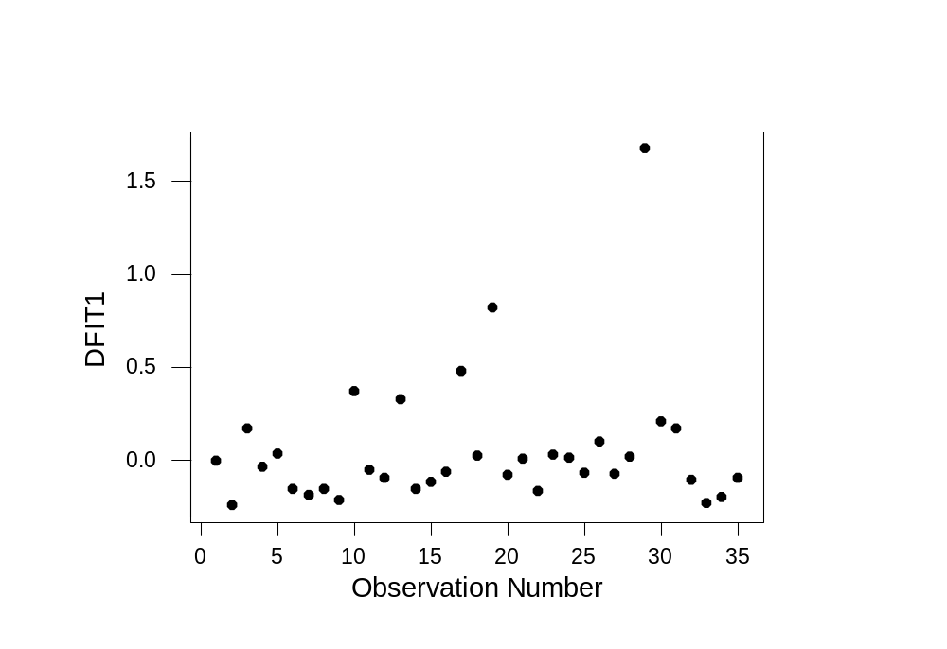
DFIT Graphed
29
19
Checking Assumptions
Copyright © 2005 Brooks/Cole, a division of Thomson Learning, Inc.

Slide 28
Cook's D
Often called Cook's Distance
Minitab also will compute these and store them.
Again, it might be best just to look for high values rather than use a cutoff.
Checking Assumptions
Copyright © 2005 Brooks/Cole, a division of Thomson Learning, Inc.

Slide 29
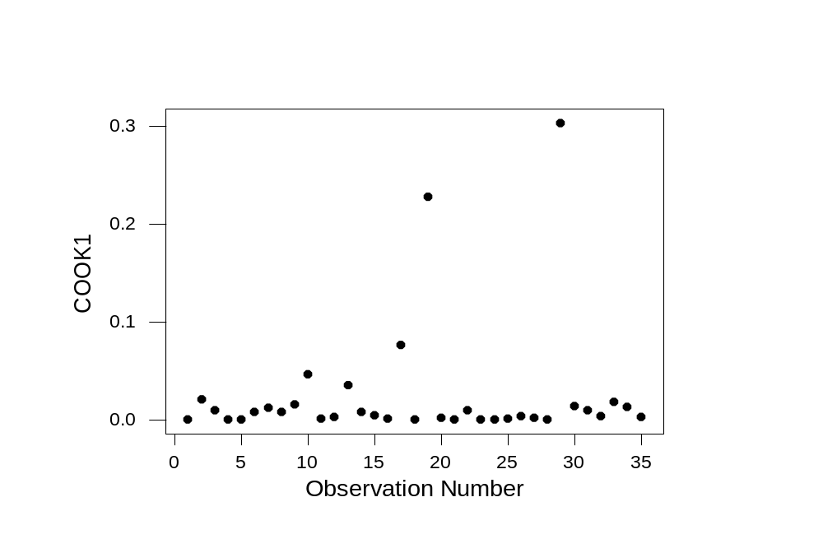
Cook's D Graphed
29
19
Checking Assumptions
Copyright © 2005 Brooks/Cole, a division of Thomson Learning, Inc.

Slide 30
6.7.5 What to do with Unusual Observations
Observation 19 (First Lincoln Financial Bank) has high influence because of its very low Sigma.
Observation 29 (Mercury Saving) had a very high return of 13.05 but its Beta and Sigma were not unusual.
Since both values are out of line with the other S&L banks, they may represent data recording errors.
Checking Assumptions
Copyright © 2005 Brooks/Cole, a division of Thomson Learning, Inc.

Slide 31
Eliminate? Adjust?
If you can do further research you might find out the true story.
You should eliminate an outlier data point only when you are convinced it does not belong with the others (for example, if Mercury was speculating wildly).
An alternative is to keep the data point but add an indicator variable to the model that signals there is something unusual about this observation.
Checking Assumptions
Copyright © 2005 Brooks/Cole, a division of Thomson Learning, Inc.

Slide 32
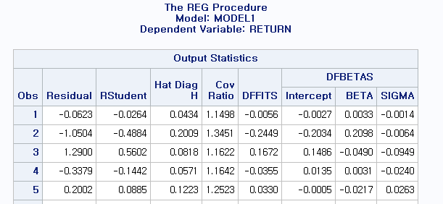


proc reg ; model return = beta sigma / influence ; run;
Checking Assumptions
Copyright © 2005 Brooks/Cole, a division of Thomson Learning, Inc.

Slide 33
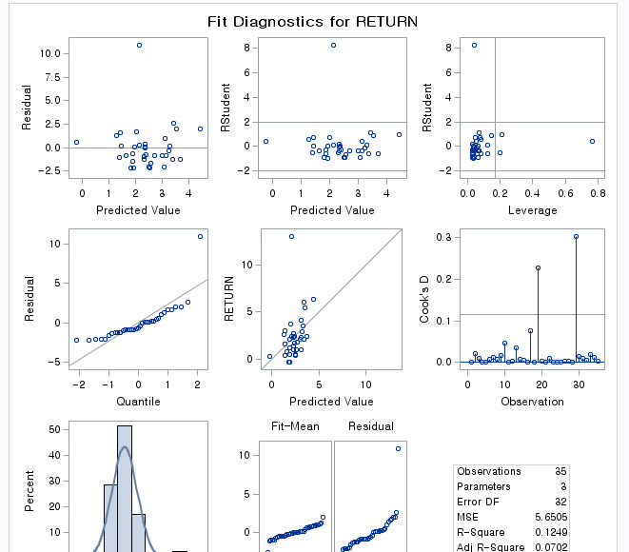
Checking Assumptions
Copyright © 2005 Brooks/Cole, a division of Thomson Learning, Inc.

Slide 34
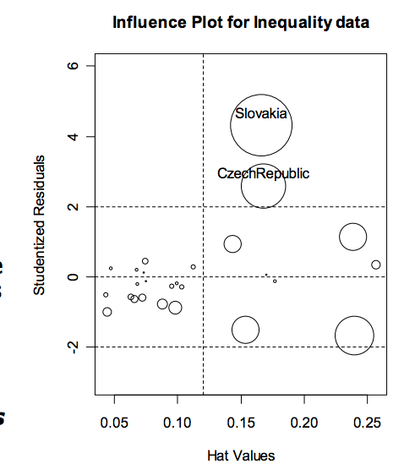
Bubble Plot for Cook’s D
Checking Assumptions
Copyright © 2005 Brooks/Cole, a division of Thomson Learning, Inc.

Slide 35
6.8 Assessing the Assumption That the Disturbances are Independent
If the disturbances are independent, the residuals should not display any patterns.
One such pattern was the curvature in the residuals from the linear model in the telemarketing example.
Another pattern occurs frequently in data collected over time.
Checking Assumptions
Copyright © 2005 Brooks/Cole, a division of Thomson Learning, Inc.

Slide 36
6.8.1 Autocorrelation
In time series data we often find that the disturbances tend to stay at the same level over consecutive observations.
If this feature, called autocorrelation, is present, all our model inferences may be misleading.
Checking Assumptions
Copyright © 2005 Brooks/Cole, a division of Thomson Learning, Inc.

Slide 37
First-order autocorrelation
If the disturbances have first-order autocorrelation, they behave as:
e_{i} = ρ e_{i-1} + µ_{i}
where µ_{i} is a disturbance with expected value 0 and independent over time.
Checking Assumptions
Copyright © 2005 Brooks/Cole, a division of Thomson Learning, Inc.

Slide 38
The effect of autocorrelation
If you knew that e₅₆ was 10 and ρ was .7, you would expect e₅₇ to be 7 instead of zero.
This dependence can lead to high standard errors for the b_{j} coefficients and wider confidence intervals.
Checking Assumptions
Copyright © 2005 Brooks/Cole, a division of Thomson Learning, Inc.

Slide 39
6.8.2 A Test for First-Order Autocorrelation
Durbin and Watson developed a test for positive autocorrelation of the form:
H₀: ρ = 0
H_{a}: ρ > 0
Their test statistic d is scaled so that it is 2 if no autocorrelation is present and near 0 if it is very strong.
Checking Assumptions
Copyright © 2005 Brooks/Cole, a division of Thomson Learning, Inc.

Slide 40
A Three-Part Decision Rule
The Durbin-Watson test distribution depends on n and K. The tables (Table B.7) list two decision points d_{L} and d_{U}.
If d < d_{L} reject H₀ and conclude there is positive autocorrelation.
If d > d_{U} accept H₀ and conclude there is no autocorrelation.
If d_{L} ≤ d ≤ d_{U} the test is inconclusive.
Checking Assumptions
Copyright © 2005 Brooks/Cole, a division of Thomson Learning, Inc.

Slide 41
Example 6.10 Sales and Advertising
n = 36 years of annual data
Y = Sales (in million $)
X = Advertising expenditures ($1000s)
Data in Table 6.6
Checking Assumptions
Copyright © 2005 Brooks/Cole, a division of Thomson Learning, Inc.

Slide 42
The Test
n = 36 and K = 1 X-variable
At a 5% level of significance, Table B.7 gives d_{L} = 1.41 and d_{U} = 1.52
Decision Rule:
  Reject H₀ if d < 1.41
  Accept H₀ if d > 1.52
  Inconclusive if 1.41 ≤ d ≤ 1.52
Checking Assumptions
Copyright © 2005 Brooks/Cole, a division of Thomson Learning, Inc.

Slide 43
Regression With DW Statistic
The regression equation is
Sales = - 633 + 0.177 Adv
Predictor Coef SE Coef T P
Constant -632.69 47.28 -13.38 0.000
Adv 0.177233 0.007045 25.16 0.000
S = 36.49 R-Sq = 94.9% R-Sq(adj) = 94.8%
Analysis of Variance
Source DF SS MS F P
Regression 1 842685 842685 632.81 0.000
Residual Error 34 45277 1332
Total 35 887961
Unusual Observations
Obs Adv Sales Fit SE Fit Residual St Resid
1 5317 381.00 309.62 11.22 71.38 2.06R
15 6272 376.10 478.86 6.65 -102.76 -2.86R
R denotes an observation with a large standardized residual
Durbin-Watson statistic = 0.47
Significant autocorrelation
Checking Assumptions
Copyright © 2005 Brooks/Cole, a division of Thomson Learning, Inc.

Slide 44
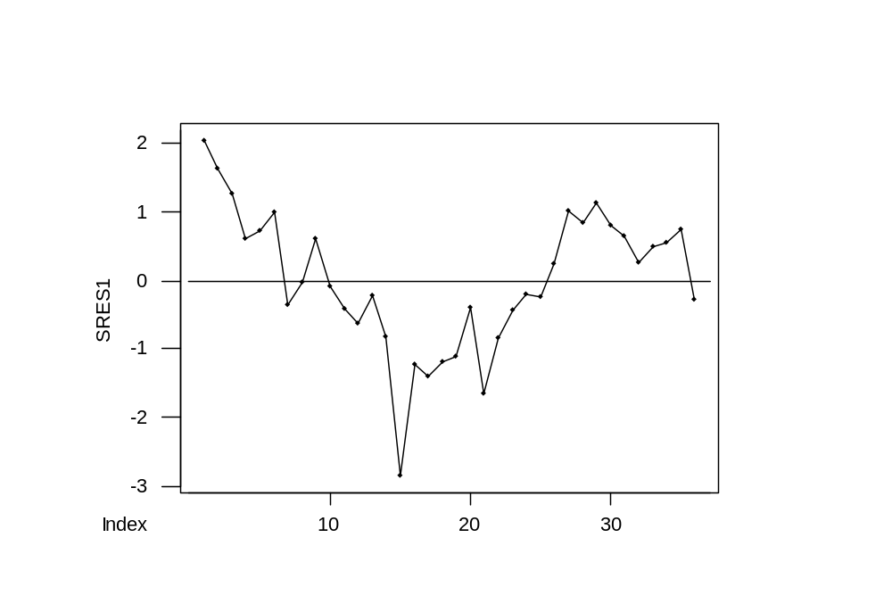
Plot of Residuals over Time
Shows first-order autocorrelation with r = .71
Checking Assumptions
Copyright © 2005 Brooks/Cole, a division of Thomson Learning, Inc.

Slide 45
proc reg ; model return = beta sigma / dwprob ; output out=res_out r=res ; run; proc sgplot data=res_out ; series x=time y=res; refline 0.0 ; run;
Checking Assumptions
Copyright © 2005 Brooks/Cole, a division of Thomson Learning, Inc.

Slide 46
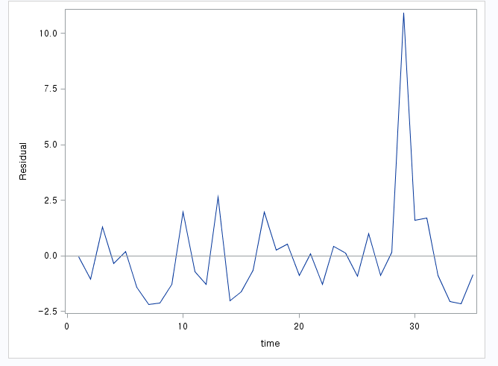
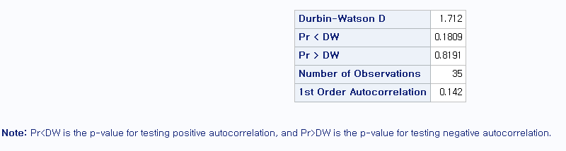
Checking Assumptions
Copyright © 2005 Brooks/Cole, a division of Thomson Learning, Inc.

Slide 47
6.8.3 Correction for First-Order Autocorrelation
One popular approach creates a new y and x variable.
First, obtain an estimate of ρ. Here we use r = .71 from Minitab's Autocorrelation analysis.
Then compute y_{i}* = y_{i} – r y_{i-1}
and x_{i}* = x_{i} – r x_{i-1}
Checking Assumptions
Copyright © 2005 Brooks/Cole, a division of Thomson Learning, Inc.

Slide 48
First Observation Missing
Because the transformation depends on lagged y and x values, the first observation requires special handling.
The text suggests y₁* = √1 – r² y₁
and a similar computation for x₁*
Checking Assumptions
Copyright © 2005 Brooks/Cole, a division of Thomson Learning, Inc.

Slide 49
Other Approaches
An alternative is to use an estimation technique (such as SAS's Autoreg procedure) that automatically adjusts for autocorrelation.
A third option is to include a lagged value of y as an explanatory variable. In this model, the DW test is no longer appropriate.
Checking Assumptions
Copyright © 2005 Brooks/Cole, a division of Thomson Learning, Inc.

Slide 50
Regression With Lagged Sales as a Predictor
The regression equation is
Sales = - 234 + 0.0631 Adv + 0.675 LagSales
35 cases used 1 cases contain missing values
Predictor Coef SE Coef T P
Constant -234.48 78.07 -3.00 0.005
Adv 0.06307 0.02023 3.12 0.004
LagSales 0.6751 0.1123 6.01 0.000
S = 24.12 R-Sq = 97.8% R-Sq(adj) = 97.7%
Analysis of Variance
(deleted)
Unusual Observations
Obs Adv Sales Fit SE Fit Residual St Resid
15 6272 376.10 456.24 5.54 -80.14 -3.41R
16 6383 454.60 422.02 12.95 32.58 1.60 X
21 6794 512.00 559.41 4.46 -47.41 -2.00R
R denotes an observation with a large standardized residual
X denotes an observation whose X value gives it large influence.
Checking Assumptions
Copyright © 2005 Brooks/Cole, a division of Thomson Learning, Inc.

Slide 51
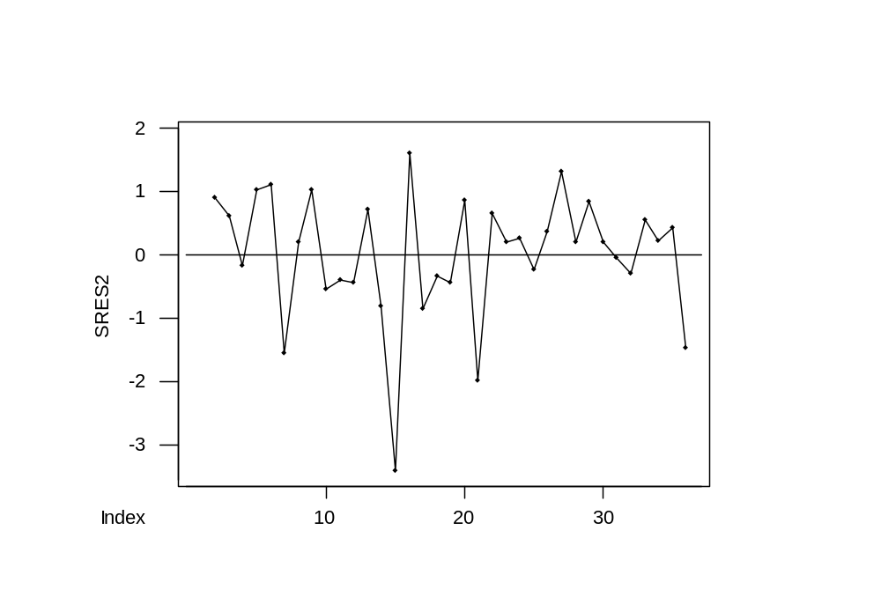
Residuals From Model With Lagged Sales
Now r = -.23 is not significant
Checking Assumptions
Copyright © 2005 Brooks/Cole, a division of Thomson Learning, Inc.

